Slide 1
Surgery Clerkship Orientation

Slide 2
Welcome to Surgery
Clerkship Director
Lee Hallagan MD
585-259-4267
Lee.Hallagan@mainehealth.org
Clerkship Coordinator
Danielle Shaw
Danielle.Shaw@mainehealth.org
Helpful links
Amion.com
Surg.me
Canvas

Slide 3
Structure of the clerkship

Slide 4
Weekday rotations

Slide 5
Call/Night float

Slide 6
Goals and objectives

Slide 7
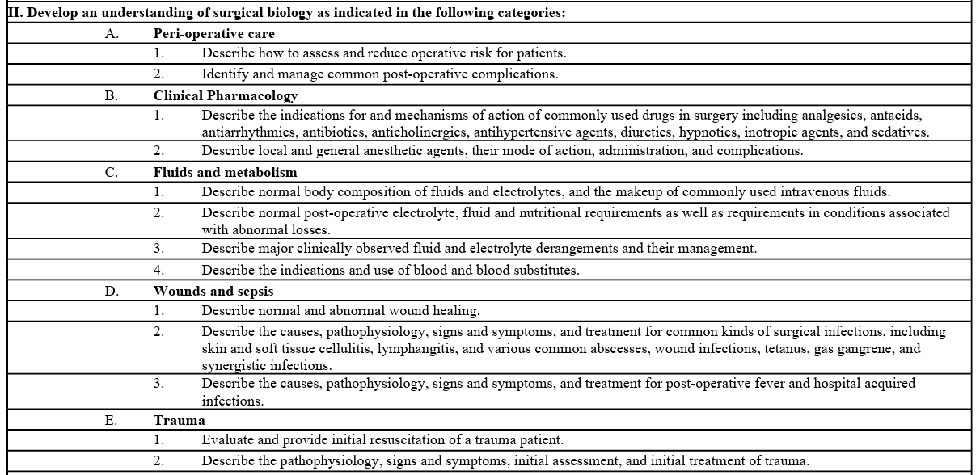

Slide 9
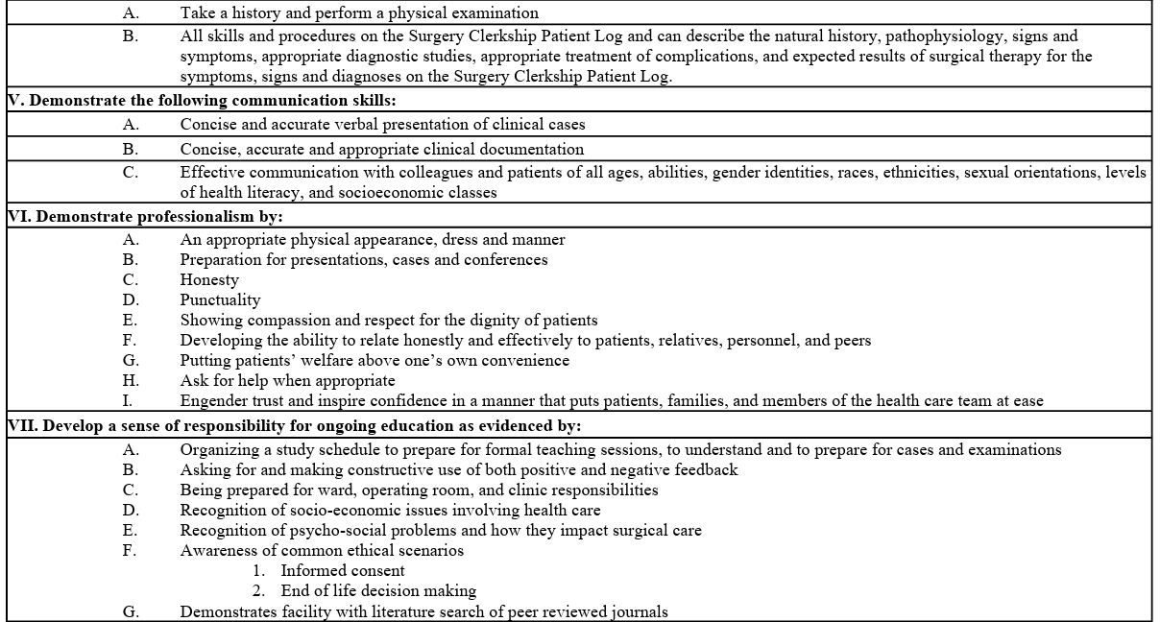

Slide 11
Expectations

Slide 12
Student Conferences
Faculty lectures
Schedule TBD
Thursdays
10am
Case presentations with Radke
11am
Clerkship director meetings
Hi Fidelity simulation
Mid-rotation, end of rotation meetings

Slide 13
Departmental Conferences (surg.me)
Monday
Didactics
7am
Thursday
7am: Resident didactics
8am: M&M
9am: Grand rounds
10am: Chair conference (if no Radke conference)

Slide 14
Office/Clinic
You should attend at least ½ day of clinic per week
Excluding NF, EGS, SCU
See https://surg.me/content/medical-students for info on services and location of offices
Office day will be arranged by your chief resident
Schedule available through epic

Slide 15
Operative cases
Assignment per chief resident
Schedule link available through surg.me
“You are expected to participate fully in any operation on a patient assigned to you. You should be present in proper attire at least ten minutes prior to the scheduled time of operation and assist in preparations. During the operation you will serve generally as a second assistant with specified duties throughout the operation. You are encouraged to ask pertinent questions relating to surgical anatomy and the operative procedures, but you should be familiar with the patient's record and read your texts in advance since you may be questioned as well. You will be excused from the operating room only because of illness, emergencies, a conflict with an operation on another service, school holidays and vacations. This must be communicated to the chief resident or attending on the service prior to the case.”

Slide 16
Rounds and Ward duties
Students are expected to follow 2 patients at any given time
Present them during morning or afternoon rounds
Students should see at least 1 consult per week
Writing notes
Daily progress notes
History and physical / consult notes
Brief op notes
Post op checks

Slide 17
Rounds and Ward duties
“free time”
“Students should also utilize free time in the afternoons to spend extra time with their patients exploring psychosocial issues, or associated medical issues, which can be very important in patients undergoing major surgery.”
Ward duties
Sticky notes/discharge summaries
Remove drains, change dressings, remove staples, remove ng tubes etc
Follow up on procedures/tests
Check in with discharge coordinator, nurse, RT, pharmacist etc
Library / call rooms

Slide 18
Orientation Day 2

Slide 19
Requirements
Doc cards
Case logs
Wise md cases
Oral presentation

Slide 20
Evaluations
Med-hub

Slide 21
How to Learn
Clinical exposure
Question banks
Wise-MD
Books
Quick study/before a case
Surgical Recall
Dr. Pestana’s Surgery notes
Oral exam
NMS Surgery Casebook
De Virgilio Surgery
Comprehensive
Current Diagnosis and Treatment Surgery
Essentials of General Surgery – Lawrence
Sabiston, Schwartz, Cameron’s

Slide 22
Service descriptions

Slide 23
Trauma

Slide 24
Hallagan office/OR
Tuesday Feb 6: Emily (MIS)
Tuesday Feb 27: Rory (MIS)
Tuesday March 5: Josh (colorectal)
OR
Friday Feb 9: Peter (surg onc)
Monday feb 26: Anne (colorectal)
Friday march 1: Amelia (vascular)

Slide 25
Final week
Amelia: burn, thoracic or transplant
Hi Amelia,
-Transplant is combined with the elective general surgery service (Chris Demme will be chief). So you could join them. Importantly, they usually do a transplant on Tuesday mornings that you could see.
-Audria is the resident on the burn service that week- so that would be fine.
-There is no resident on thoracic that week so this is less ideal (we can still make it work once we see what cases are going later on).

