Slide 1
Surgery Clerkship Orientation

Slide 2
Welcome to Surgery
Clerkship Director
Lee Hallagan MD
585-259-4267
Lee.Hallagan@mainehealth.org
Clerkship Coordinator
Quinn Redmond
Quinn.Redmond@mainehealth.org
Helpful links
Amion.com
Surg.me
Canvas

Slide 3
Structure of the clerkship

Slide 4

Weekday rotations

Slide 5
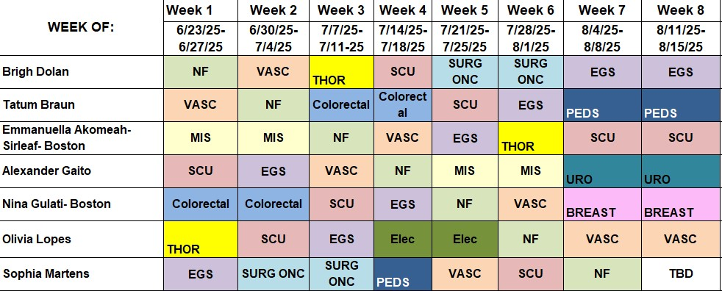

Slide 6
Call/Night float

Slide 8
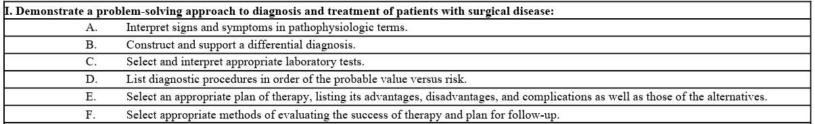
Goals and objectives

Slide 9
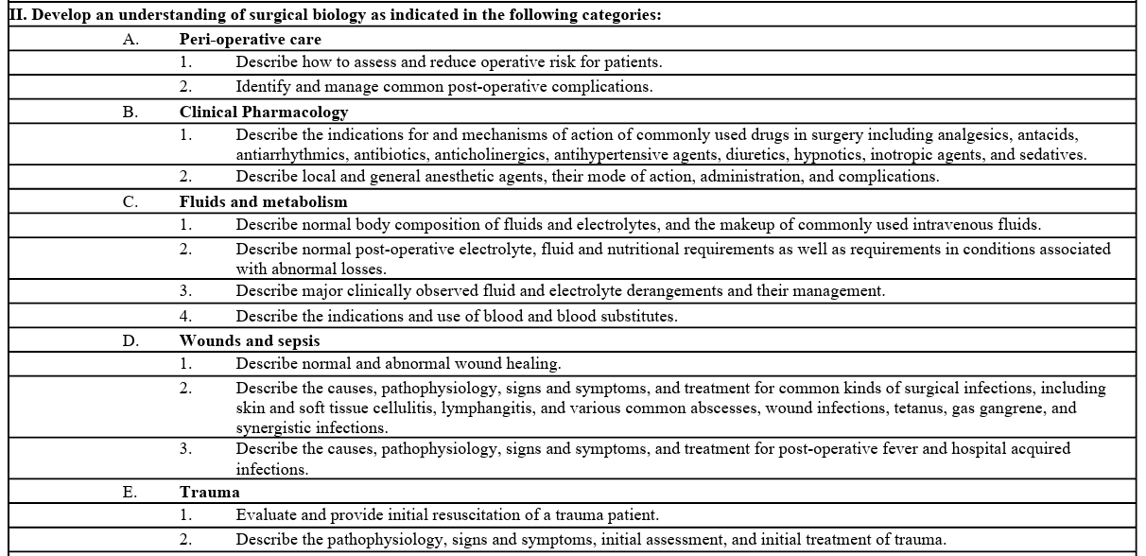

Slide 11
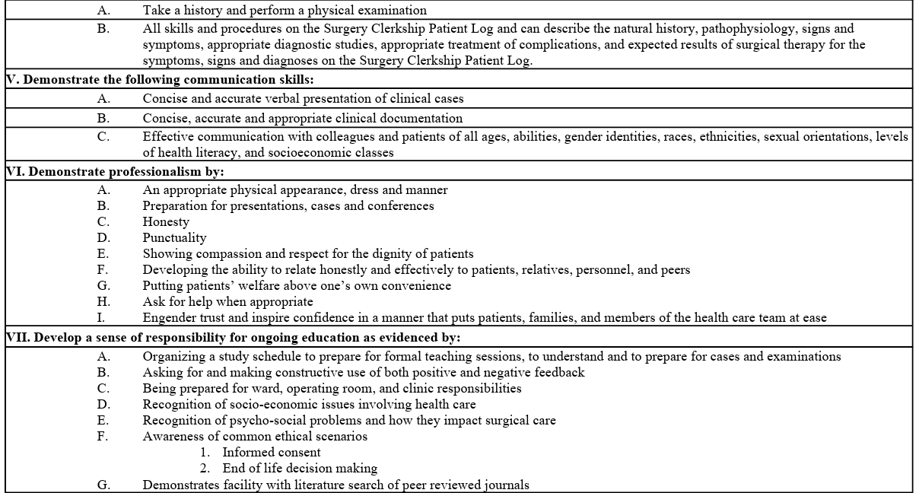

Slide 12
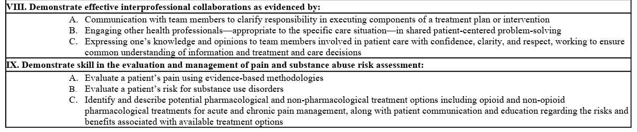

Slide 13
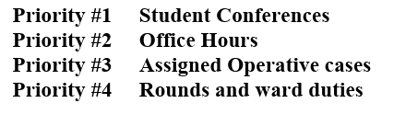
Expectations

Slide 14
Student Conferences
Faculty lectures
Schedule TBD
Thursdays
Departmental conferences
Hi Fidelity simulation
Mid-rotation, end of rotation meetings
Clerkship director meetings

Slide 15
Departmental Conferences
(surg.me)
Monday
Didactics
7am
Thursday
7am: Resident didactics
8am: M&M
9am: Grand rounds
10am: Chair conference

Slide 16

Office/Clinic
You should attend at least ½ day of clinic per week
  Excluding NF, EGS, SCU
See https://surg.me/content/medical-students for info on services and location of offices
Office day will be arranged by your chief resident
  Schedule available through epic

Slide 17
Operative cases
Assignment per chief resident
  Schedule link available through surg.me
“You are expected to participate fully in any operation on a patient assigned to you. You should be present in proper attire at least ten minutes prior to the scheduled time of operation and assist in preparations. During the operation you will serve generally as a second assistant with specified duties throughout the operation. You are encouraged to ask pertinent questions relating to surgical anatomy and the operative procedures, but you should be familiar with the patient's record and read your texts in advance since you may be questioned as well. You will be excused from the operating room only because of illness, emergencies, a conflict with an operation on another service, school holidays and vacations. This must be communicated to the chief resident or attending on the service prior to the case.”

Slide 18
Rounds and Ward duties
Students are expected to follow 2 patients at any given time
  Present them during morning or afternoon rounds
Students should see at least 1 consult per week
Writing notes
  Daily progress notes
  History and physical / consult notes
  Brief op notes
  Post op checks

Slide 19
Rounds and Ward duties
“free time”
  “Students should also utilize free time in the afternoons to spend extra time with their patients exploring psychosocial issues, or associated medical issues, which can be very important in patients undergoing major surgery.”
  Ward duties
    Sticky notes/discharge summaries
    Remove drains, change dressings, remove staples, remove ng tubes etc
    Follow up on procedures/tests
    Check in with discharge coordinator, nurse, RT, pharmacist etc
  Library / call rooms

Slide 20
Orientation Day 2

Slide 21
Requirements
Surgery Doc cards (2)
Surgery Pain DOC card (1)
Written H&P (3)
Diagnostic Assessment/Reasoning Tool (DART) (1)
Oral presentation (Timing TBD)
Case logs (60)

Slide 22
Evaluations
Students will identify staff who receive evaluation request electronically through MedHub
Evaluations can come from any staff (attending, resident, APP, pharmacist, nurse, CRNA etc)
Students should anticipate getting at least 6 evaluation by end of rotation

Slide 23
Evaluations- Domains Evaluated
Knowledge
Patient Care: Clinical Reasoning
Patient Care: History-taking
Patient Care: Physical Exam
Communication Skills: Presentations
Communication Skills: Notes
Communication Skills: Patients
Professionalism: Conduct as a Learner/Team-member
Professionalism: Professional manner with patients
Practice-Based Learning and Improvement
Interprofessional Collaboration
Personal and Professional Development
Systems-Based Practice

Slide 24
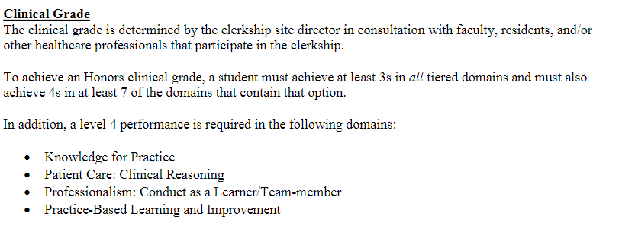
Grading

Slide 25
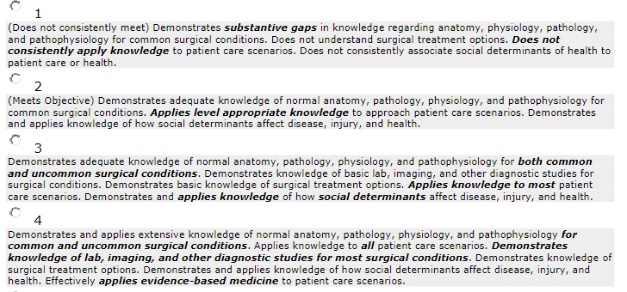
Knowledge for Practice

Slide 26
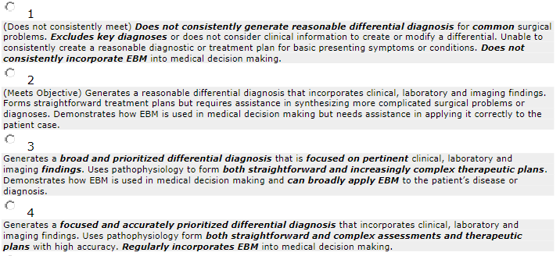
Clinical Reasoning

Slide 27
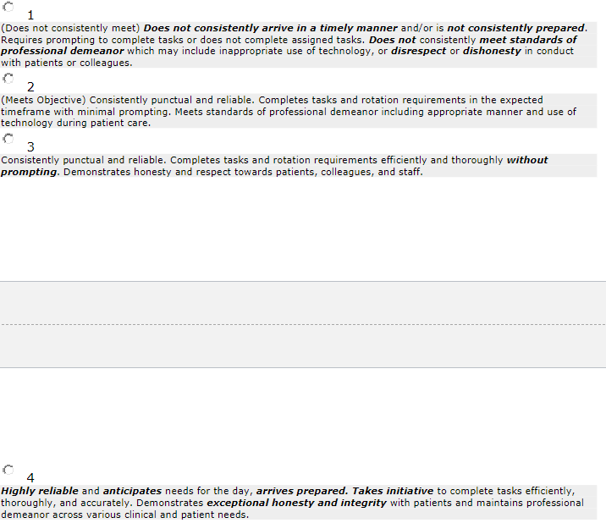
Professionalism: Conduct as a Team Member

Slide 28
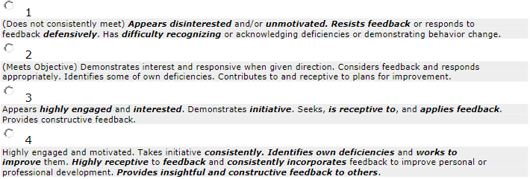
Practice Based Learning and Improvement

Slide 29
How to Learn
Clinical exposure
Question banks
Wise-MD
Books
  Quick study/before a case
    Surgical Recall
    Dr. Pestana’s Surgery notes
  Oral exam
    NMS Surgery Casebook
    De Virgilio Surgery
  Comprehensive
    Current Diagnosis and Treatment Surgery
    Essentials of General Surgery – Lawrence
    Sabiston, Schwartz, Cameron’s

Slide 30
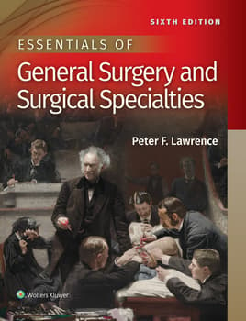

Studying for the Shelf
- Lawrence
- ACS/ASE Medical Student Core Curriculum

Slide 31
Surgery Shelf exam
Lawrence text book
ACS ASE medical student core curriculum

Slide 32
Final week

