Slide 1
Oral exam review
Purpose of Exam
Format
Content
How to study for exam (content)
Preparation to the format of an oral exam
General surgery oral exam examples
Trauma lecture
Trauma oral exam structure

Slide 2
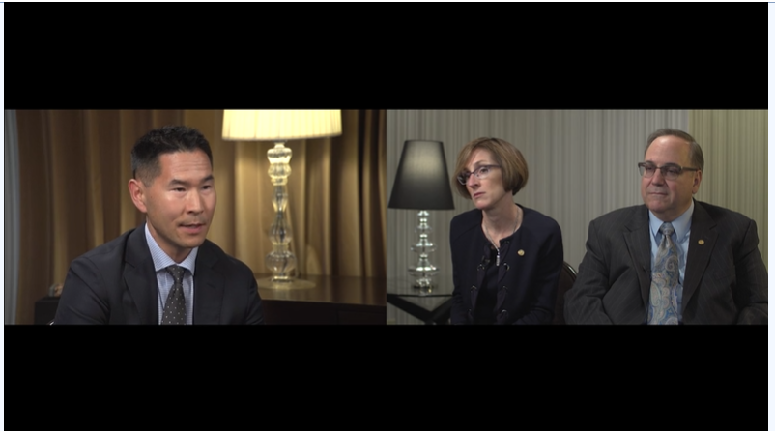
Oral exam review

Slide 3
Format
3 Scenarios
45 minutes
1 examiner
Zoom

Slide 4
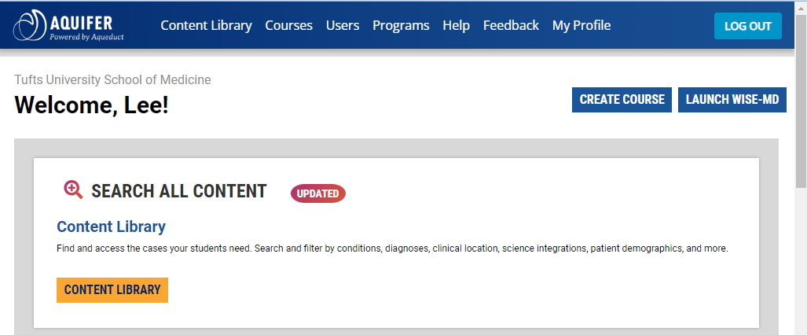
Oral exam content

Slide 5
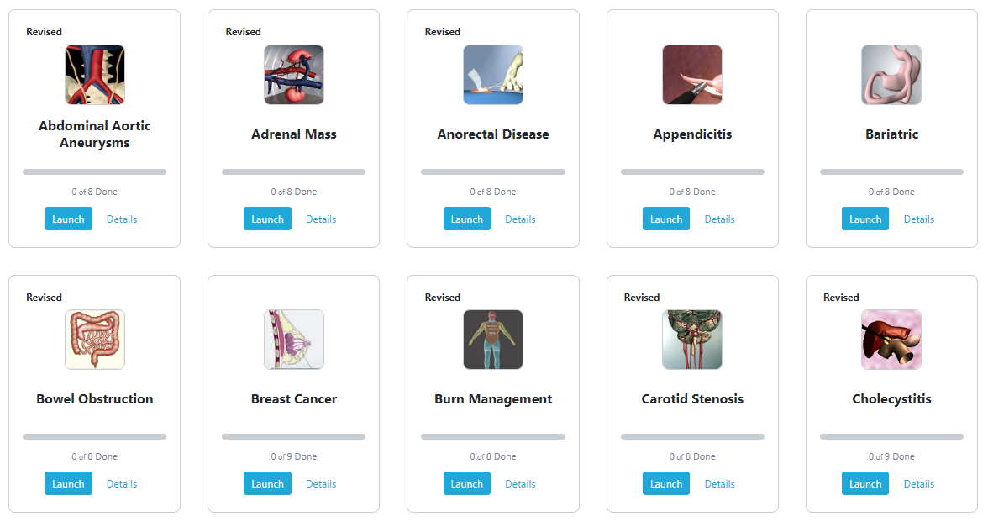

Slide 6
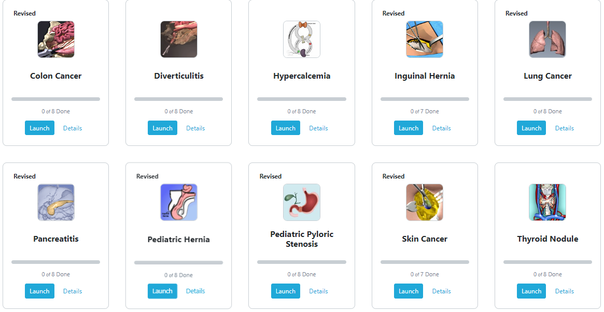

Slide 7
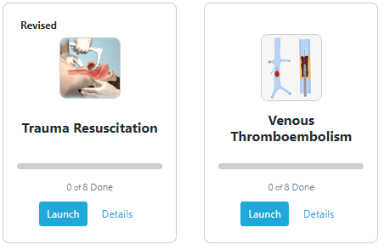

Slide 8
How to Study

Slide 9
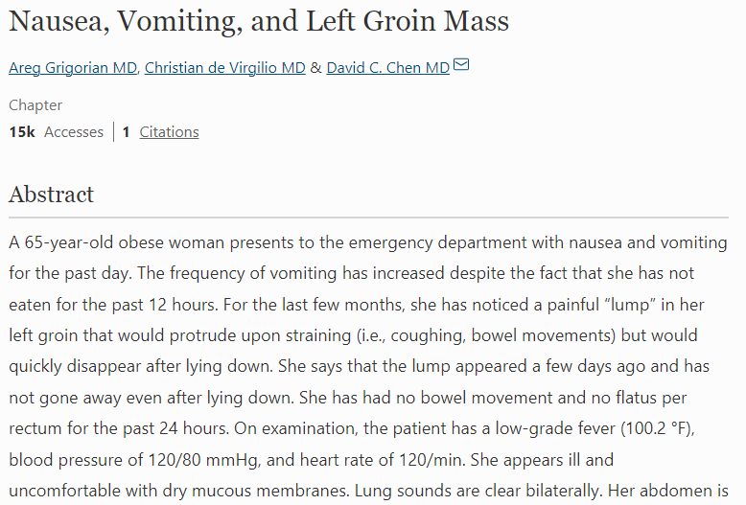
Resources

Slide 10
Oral exam scenario progression
Stem
Stabilization
History
Physical Exam
Labs, tests, imaging
Diagnosis
Management
DDx

Slide 11
Stem
Outpatient
“a 41yo female presents to your office with a funny looking nevus. She reports that she never noticed it until 2 weeks ago. She is otherwise feeling fine”
Inpatient
“a 65 yo male presents to the ED with 6 hours of severe upper abdominal pain. He went to bed feeling well but was awoken by severe pain and nausea. He tried taking some pepto bismol without effect”
Trauma
“a 23 yo female was found down after a motorcycle crash. She has significant facial trauma and was unresponsive at the scene”

Slide 12
Stabilization- are they sick?
Type of shock | Initial management
Septic | IVF | ABX | Source control
Neurogenic | IVF | ?pressors
Hypovolemic | IVF
Hemorrhagic | IVF | Blood
Tension Pneumo | Decompression
Cardiogenic | Support pump
Tamponade | Drain pericardium
PE | Supportive | Anticoagulation

Slide 13
Stabilization- are they sick?
Type of shock | Initial management
Septic | IVF | ABX | Source control
Neurogenic | IVF | ?pressors
Hypovolemic | IVF
Hemorrhagic | IVF | Blood
Tension Pneumo | Decompression
Cardiogenic | Support pump
Tamponade | Drain pericardium
PE | Supportive | Anticoagulation
ECG
Access
Vitals
Cardiopulmonary exam (ABCs)

Slide 14
Stabilization- are they sick?
ECG
Access
Vitals
Cardiopulmonary exam (ABCs)
“Before starting the interview I would quickly assess the patient and check their vitals…”

Slide 15
History
HPI FARCOLDER
PMHx PSHx Meds/allergies Preventative
FHx
SHx
ROS

Slide 16
History
HPI FARCOLDER
PMHx PSHx Meds/allergies Preventative
FHx
SHx
ROS
“I would next perform a history. I would want to know more about…”
“I would then ask more about their past medical history, specifically I would want to know if they had …”
“Regarding their [heart, lungs, liver etc]….”

Slide 17
Physical Exam
Vitals
Neuro
HEENT
Chest
Abdomen
Vascular
Musculoskeletal /skin
Genital/rectal

Slide 18
Physical Exam
Vitals
Neuro
HEENT
Chest
Abdomen
Vascular
Musculoskeletal /skin
Genital/rectal
“I would look at their vitals and perform a full physical exam. I would focus on ….”

Slide 19
Differential Diagnosis pause
Summary statements help tell the examiner (and yourself) where you are

Slide 20
Labs
CBC
CMP
Lipase/amylase
INR
Lactate
Genetic testing
Tumor markers
Urine metanephrines
TSH, FT4
PTH

Slide 21
Imaging/tests
ECG
CT/CTA
US
MRI/MRA/MRCP
EGD/Colonoscopy
XR
Mammogram
HIDA
Sestemibi
Biopsy (eg IR)

Slide 22
Management
Perioperative care
Are they safe for surgery?
Cardiac, pulmonary, liver disease
Nutrition
Is there time for optimization?
Operation
Should be able to walk through basic operations and have basic understanding of complex operations

Slide 23
Management
Recovery
Complications
Follow up

Slide 24
Scenario 1
index

Slide 25
Stem
You are called to the ER to see a patient with abdominal pain. The ER doc thinks its surgical and wants you to see them ASAP because they think he’s pretty sick.
The patient, Mr. Decker is a 57 yo male who suddenly developed severe upper abdominal pain while watching TV this evening. He ignored it and tried to go to bed. After midnight he developed sweats and chills and came to ED.

Slide 26
Stabilization- are they sick?

Slide 27
Stabilization- are they sick?
ECG
Access
Vitals
Cardiopulmonary exam (ABCs)

Slide 28
Stabilization- are they sick?
ECG
Access
Vitals
Cardiopulmonary exam (ABCs)
Ill appearing, lethargic, diaphoretic
pulse 115 BP 90/50 Temp 38.5 RR 20
ECG normal
Lungs clear, tachy

Slide 29
Stabilization- are they sick?
ECG
Access
Vitals
Cardiopulmonary exam (ABCs)
Ill appearing, lethargic, diaphoretic
pulse 115 BP 90/50 Temp 38.5 RR 20
ECG normal
Lungs clear, tachy
IVF
?ABX

Slide 30
History
HPI FARCOLDER
PMHx PSHx Meds/allergies Preventative
FHx
SHx
ROS

Slide 31
History
HPI FARCOLDER
PMHx PSHx Meds/allergies Preventative
FHx
SHx
ROS
DDX

Slide 32
History
HPI FARCOLDER
PMHx PSHx Meds/allergies Preventative
FHx
SHx
ROS
DDX
Cholecystitis
Pancreatitis
Cholangitis
PUD
Appendicitis
Diverticulitis
Bowel obstruction
Hernia
Mesenteric ischemia

Slide 33
History
HPI FARCOLDER
PMHx PSHx Meds/allergies Preventative
FHx
SHx
ROS
Better characterize pain
Reflux, biliary colic, diverticulitis Abdominal surgeries Meds: antacids, NSAIDS
FHx- NA
SHx- smoking, ETOH
ROS
DDx
Cholecystitis
Pancreatitis
Cholangitis
PUD
Appendicitis
Diverticulitis
Bowel obstruction
Hernia
Mesenteric ischemia

Slide 34
History
Started suddenly, progressively worse over time, associated with some nausea, sweats, chills, subjective fever
Has never had anything like this before
PMhx/PsHx
Was told he has gallstones
Occasionally takes tums for heartburn
Takes ibuprofen for arthritis (“lots”)
s/p L inguinal hernia repair
Remainder of history non contributory
No other meds, no allergies, drinks socially

Slide 35
Physical Exam
Vitals
Neuro
HEENT
Chest
Abdomen
Vascular
Musculoskeletal /skin
Genital/rectal
DDx
Cholecystitis
Pancreatitis
Cholangitis
PUD
Appendicitis
Diverticulitis
Bowel obstruction
Hernia
Mesenteric ischemia

Slide 36
Physical Exam
Vitals
Neuro
HEENT
Chest
Abdomen
Vascular
Musculoskeletal /skin
Genital/rectal
“I would do a full physical exam but focus on the…”
Abdomen
Genital/rectal
DDx
Cholecystitis
Pancreatitis
Cholangitis
PUD
Appendicitis
Diverticulitis
Bowel obstruction
Hernia
Mesenteric ischemia

Slide 37
PE
Ill appearing male, pale, lethargic, diaphoretic VSS: pulse 115 BP 90/50 Temp 38.5 RR 20
Abdomen exam
Firm
+rebound tenderness in epigastrium
Epigastric guarding
Remainder of exam negative

Slide 38
Differential diagnosis pause

Slide 39
Labs
CBC
CMP
Lipase/amylase
INR
Lactate
Genetic testing
Tumor markers
Urine metanephrines
TSH, FT4
PTH
DDx
Cholecystitis
Pancreatitis
Cholangitis
PUD
↓ Appendicitis
↓ Diverticulitis
↓ Bowel obstruction
↓ Hernia
↓ Mesenteric ischemia

Slide 40
Labs
CBC
CMP
Lipase/amylase
INR
Lactate
Genetic testing
Tumor markers
Urine metanephrines
TSH, FT4
PTH
CBC
CMP
Lipase/amylase
Lactate
DDx
Cholecystitis
Pancreatitis
Cholangitis
PUD
↓ Appendicitis
↓ Diverticulitis
↓ Bowel obstruction
↓ Hernia
↓ Mesenteric ischemia

Slide 41
Labs
WBC 22K HCT 45
CMP normal other than Alk phos 150
Lipase 90
Lactate 3.1

Slide 42
Imaging/tests
ECG
CT/CTA
US
MRI/MRA/MRCP
EGD/Colonoscopy
XR
Mammogram
HIDA
Sestemibi
Biopsy (eg IR)
DDx
Cholecystitis
↓ Pancreatitis
↓ Cholangitis
PUD
↓ Appendicitis
↓ Diverticulitis
↓ Bowel obstruction
↓ Hernia
↓ Mesenteric ischemia

Slide 43
Imaging/tests
ECG
CT/CTA
US
MRI/MRA/MRCP
EGD/Colonoscopy
XR
Mammogram
HIDA
Sestemibi
Biopsy (eg IR)
CT/CTA
US
MRI/MRA/MRCP
EGD/Colonoscopy
XR
DDx
Cholecystitis
↓ Pancreatitis
↓ Cholangitis
PUD
↓ Appendicitis
↓ Diverticulitis
↓ Bowel obstruction
↓ Hernia
↓ Mesenteric ischemia

Slide 44
Imaging
CT
Free air with stranding around the first portion of the duodenum and extravasation of oral contrast, large amount of free fluid

Slide 45
Management
Perioperative care
Operation
Recovery
Complications
Follow up

Slide 46
Management
Perioperative care
ABX, PPI
Operation
Omental patch
Drain
Complex: antrectomy
Recovery
Bowel rest, ng tube
Complex: antrectomy
Follow up
PPI
H. Pylori
EGD

Slide 47
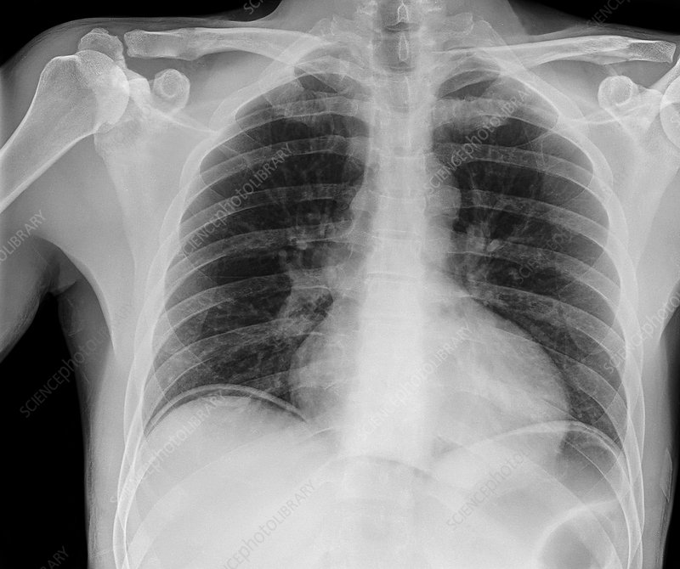
index

Slide 48
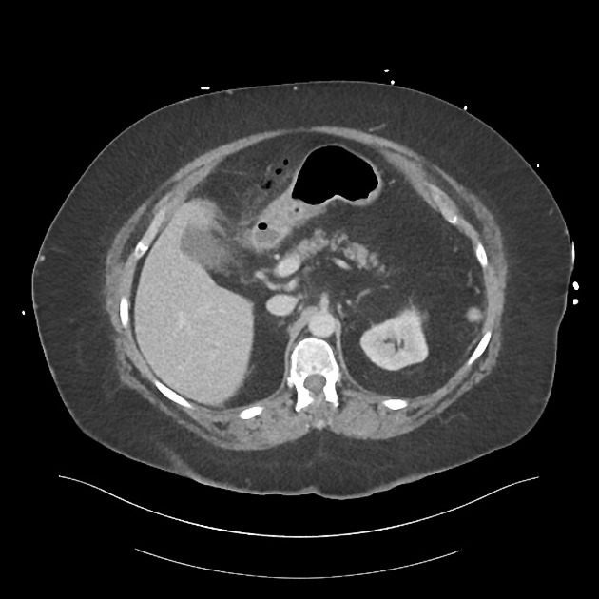
index

Slide 49
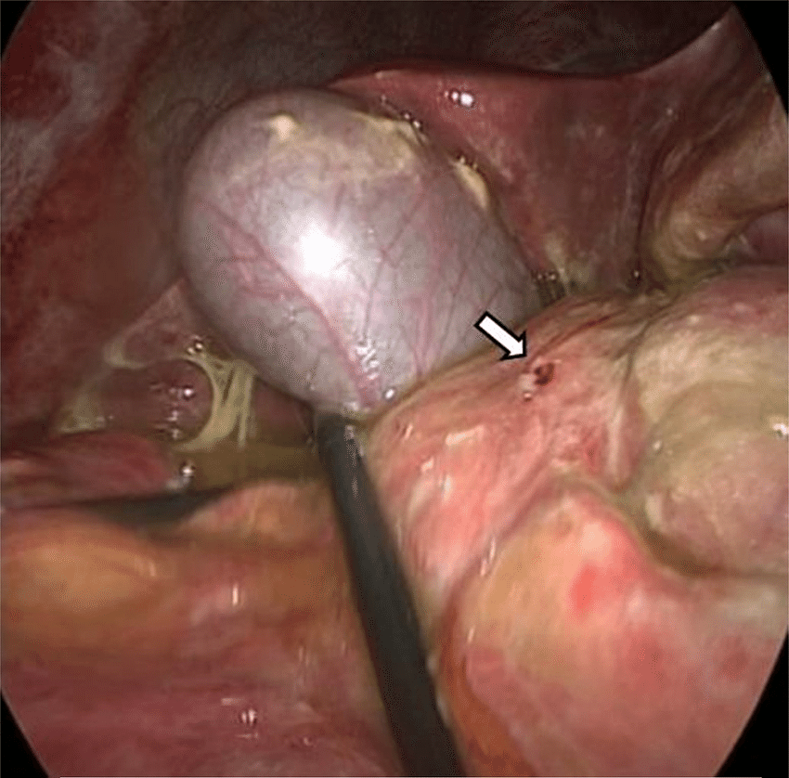
index

Slide 50
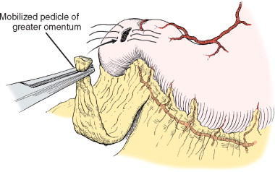
Omental patch (Graham)
index

Slide 51
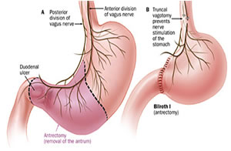

Slide 52
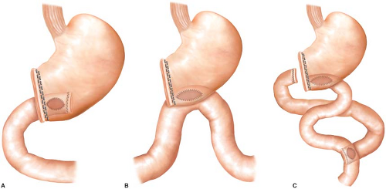

Slide 53
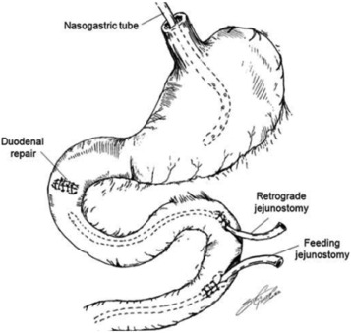

Slide 54
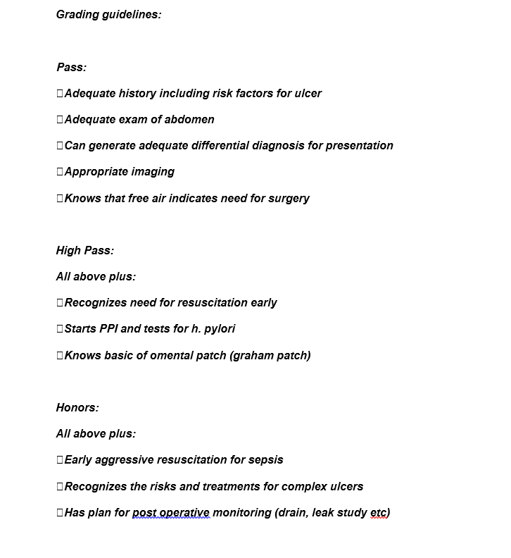
Grading

Slide 55
Scenario 2
67 yo female referred to your office with recurrent episodes of diverticulitis
Notes:
Cardiac history, anticoagulation etc.
Too sick, comes back with perforation, septic shock, damage control

Slide 56
Stabilization- are they sick?
ECG
Access
Vitals
Cardiopulmonary exam (ABCs)

Slide 57
Stabilization- are they sick? NO
ECG
Access
Vitals
Cardiopulmonary exam (ABCs)

Slide 58
History
HPI FARCOLDER
PMHx PSHx Meds/allergies Preventative
FHx
SHx
ROS

Slide 59
Physical Exam
Vitals
Neuro
HEENT
Chest
Abdomen
Vascular
Musculoskeletal /skin
Genital/rectal

Slide 60
Labs
CBC
CMP
Lipase/amylase
INR
Lactate
Genetic testing
Tumor markers
Urine metanephrines
TSH, FT4
PTH

Slide 61
Imaging/tests
ECG
CT/CTA
US
MRI/MRA/MRCP
EGD/Colonoscopy
XR
Mammogram
HIDA
Sestemibi
Biopsy (eg IR)

Slide 62
Management
Perioperative care
Operation
Recovery
Complications
Follow up

Slide 63
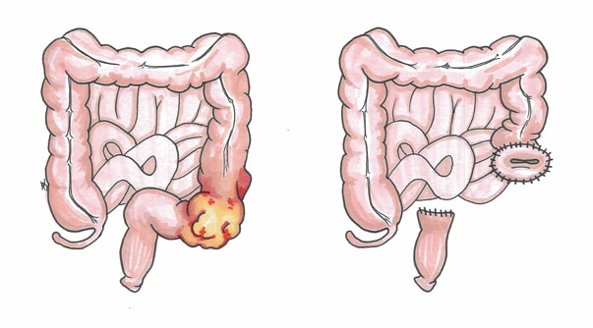

Slide 64
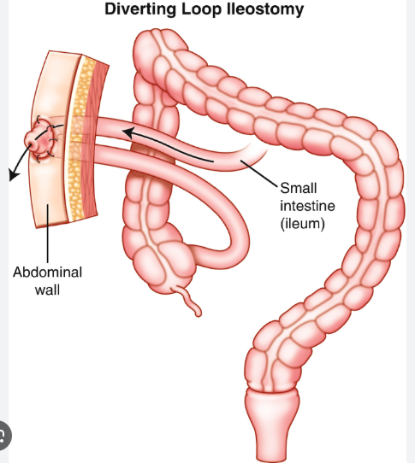

Slide 65
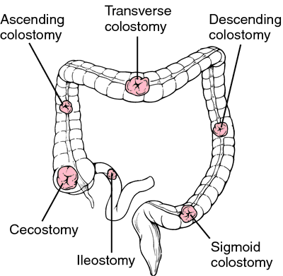
index

Slide 66
index

Slide 67
Scenario 3
A 45-year-old lady is admitted with a thirty-six hour history of progressively severe upper abdominal pain. Although she has had occasional postprandial epigastric discomfort (especially to fatty foods) for several years she has never had abdominal pain this severe.
Notes:
cholangitis

Slide 68
Scenario 4
A 78-year-old female who had a colon carcinoma resected four years ago presents to the hospital with a history of two weeks of intermittent nausea and vomiting. Her abdomen is distended with hyperactive bowel sounds.

Slide 69
Scenario 5
You are called to see a 26-year-old male who has presented to the ED with 72 hours of pain localized to the right lower quadrant. The pain began with an episode of vomiting, followed by watery diarrhea. He had had similar pain in the past but not as severe. He reports to you that on the ride to the hospital all the bumps in the road exacerbated his discomfort.

Slide 70
Stabilization- are they sick?
ECG
Access
Vitals
Cardiopulmonary exam (ABCs)

Slide 71
History
HPI FARCOLDER
PMHx PSHx Meds/allergies Preventative
FHx
SHx
ROS

Slide 72
Physical Exam
Vitals
Neuro
HEENT
Chest
Abdomen
Vascular
Musculoskeletal /skin
Genital/rectal

Slide 73
Labs
CBC
CMP
Lipase/amylase
INR
Lactate
Genetic testing
Tumor markers
Urine metanephrines
TSH, FT4
PTH

Slide 74
Imaging/tests
ECG
CT/CTA
US
MRI/MRA/MRCP
EGD/Colonoscopy
XR
Mammogram
HIDA
Sestemibi
Biopsy (eg IR)

Slide 75
Management
Perioperative care
Operation
Recovery
Complications
Follow up

