Slide 1
Oral exam review
Introduction to the Oral exam
Purpose of Exam
Format
Content
How to study for exam (content)
Preparation to the format of an oral exam
Introduction to Trauma

Slide 2
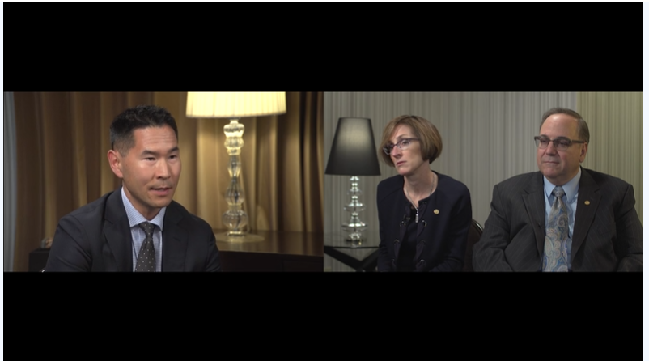
Oral exam review

Slide 3
Format
3 Scenarios
45 minutes
1 examiner
Zoom

Slide 4

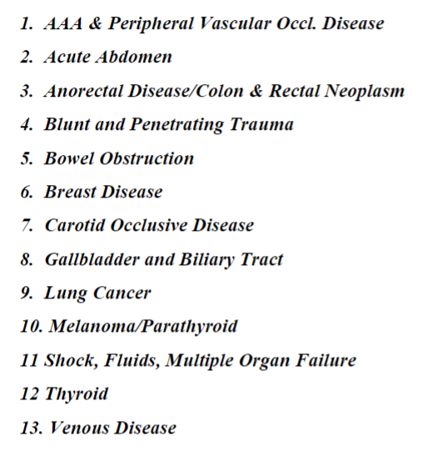

Slide 5
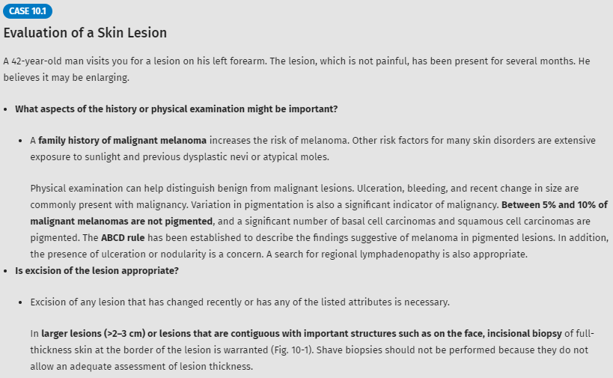
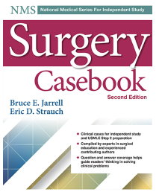
Resources

Slide 6

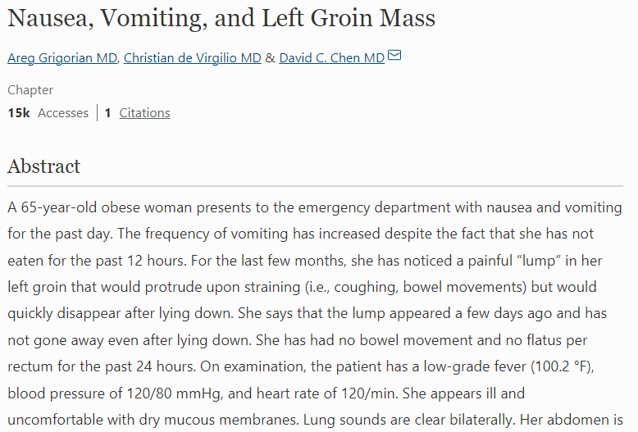
Resources

Slide 7
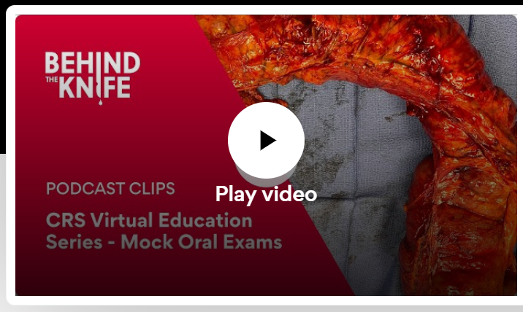
Resources

Slide 8
Resources?

Slide 9
Typical scenario format
Stem
Stabilization
History
Physical Exam
Labs, tests, imaging
Diagnosis
Management
DDx

Slide 10
Outpatient
“a 41yo female presents to your office with a funny looking nevus. She reports that she never noticed it until 2 weeks ago. She is otherwise feeling fine”
Inpatient
“a 65 yo male presents to the ED with 6 hours of severe upper abdominal pain. He went to bed feeling well but was awoken by severe pain and nausea. He tried taking some pepto bismol without effect”
Trauma
“a 23 yo female was found down after a motorcycle crash. She has significant facial trauma and was unresponsive at the scene”
Stem
Stabilization
History
Physical Exam
Labs, tests, imaging
Diagnosis
Management

Slide 11
Example- Patrick U. Davis
Stem
Stabilization
History
Physical Exam
Labs, tests, imaging
Diagnosis
Management
You are asked to see a 45 yo male in the ER with severe abdominal pain. The ER doc thinks it could be surgical and wants you to see him right away.

Slide 12
Example- Patrick U. Davis
Stem
Stabilization
History
Physical Exam
Labs, tests, imaging
Diagnosis
Management
You are asked to see a 45 yo male in the ER with severe abdominal pain. The ER doc thinks it could be surgical and wants you to see him right away.
DDx
Notes:
What is your ddx?
Very broad

Slide 13
Stabilization: Are they sick?
Stem
Stabilization
History
Physical Exam
Labs, tests, imaging
Diagnosis
Management
Clues from stem
Active bleeding
Signs of sepsis
“worried about them”
Extremis
Notes:
Skip this part in office

Slide 14
Initial Management- ABCs
Stem
Stabilization
History
Physical Exam
Labs, tests, imaging
Diagnosis
Management
Airway
Oxygen
Suction
ET tube
Breathing
Chest tube
ET tube
Circulation
Access (bilateral large bore PIV)
IVF
Massive transfusion

Slide 15
Example- Patrick U. Davis
Stem
Stabilization
History
Physical Exam
Labs, tests, imaging
Diagnosis
Management
You are asked to see a 45 yo male in the ER with severe abdominal pain. The ER doc thinks it could be surgical and wants you to see him right away.
“I would quickly review the vitals and assess ABCs by speaking with the patient and listening to their lungs and heart”
The patient is diaphoretic and lethargic. Pulse 112, bp 95/42, RR 20, sat 98%, temp 38.9. His airway is intact, he is breathing comfortably and has a thready pulse
“I’m worried they may be septic. I would establish bilateral large bore PIV and give a 1 L bolus of LR. “
You get access and some fluids started. The patient looks less lethargic, repeat vitals show p 92, bp 112/60

Slide 16
Stem
Stabilization
History
Physical Exam
Labs, tests, imaging
Diagnosis
Management
HPI FARCOLDER
PMHx PSHx Meds/allergies Preventative
FHx
SHx
ROS
Notes:
How are you going to collect all this information without using all the time?

Slide 17
Example- Patrick U. Davis
Stem
Stabilization
History
Physical Exam
Labs, tests, imaging
Diagnosis
Management
HPI FARCOLDER
“I would next perform a history. I would start by asking more about [FARCOLDER]”
Started suddenly, progressively worse over time, associated with some nausea, sweats, chills, subjective fever
“I’d like to know more about…”
Notes:
Just ask reasonable questions- don’t try to get everything. Try to think about ddx
Biliary: pain after eating, biliuria, pud: pain better after eating, pancreatitis: pain into back

Slide 18
History
Stem
Stabilization
History
Physical Exam
Labs, tests, imaging
Diagnosis
Management
HPI FARCOLDER
PMHx PSHx Meds/allergies Preventative
FHx
SHx
ROS
Notes:
How to ask this without playing “20 questions” and exibit knowledge

Slide 19
Example- Patrick U. Davis
Stem
Stabilization
History
Physical Exam
Labs, tests, imaging
Diagnosis
Management
HPI FARCOLDER
PMHx PSHx Meds/allergies Preventative
FHx
SHx
ROS
“I would then review all of their PMHx and medications. I would want to ask about…
Was told he has gallstones
Occasionally takes tums for heartburn
Takes ibuprofen for arthritis (“lots”)
s/p L inguinal hernia repair
Remainder of history non contributory No other meds, no allergies, drinks socially
“how much ibuprofen does he take per day”
“have they ever seen anyone about his gallbladder”
Notes:
How to ask this without playing “20 questions” and exibit knowledge
DDX: Biliary: gallstones, pancreatitis PUD: History of GERD, NSAIDS, smoking. Pancreatitis: lipids, alcohol
Do not have to review FHx for this question (but think about breast question)
Ok to ask follow up questions

Slide 20
Stem
Stabilization
History
Physical Exam
Labs, tests, imaging
Diagnosis
Management
Vitals
Neuro
HEENT
Chest
Abdomen
Vascular
Musculoskeletal /skin
Genital/rectal
Notes:
Examiner may ask questions

Slide 21
Stem
Stabilization
History
Physical Exam
Labs, tests, imaging
Diagnosis
Management
Vitals
Neuro
HEENT
Chest
Abdomen
Vascular
Musculoskeletal /skin
Genital/rectal
Notes:
Examiner may ask questions

Slide 22
Example- Patrick U. Davis
Stem
Stabilization
History
Physical Exam
Labs, tests, imaging
Diagnosis
Management
Vitals
Neuro
HEENT
Chest
Abdomen
Vascular
Musculoskeletal /skin
Genital/rectal
“I would then perform a full physical exam and review the most recent vitals”
“I would focus on the abdominal exam. Looking for signs of peritonitis like rebound tenderness, look for a murphy sign and perform a rectal exam”
pulse 95 BP 105/62 Temp 38.5 RR 20
Abdomen exam: Firm +rebound tenderness in epigastrium, Epigastric guarding
Remainder of exam negative
Notes:
Examiner may ask questions

Slide 23
Example- Patrick U. Davis
Stem
Stabilization
History
Physical Exam
Labs, tests, imaging
Diagnosis
Management
Differential diagnosis pause
Summary statements help tell the examiner (and yourself) where you are
“At this point, I think the patient has an acute abdomen and may need urgent surgery. This could be from a perforated viscous such as a gastric ulcer or less likely diverticulitis. He could also have cholecystitis, pancreatitis or…”
Notes:
Examiner may ask you to generate a ddx

Slide 24
Labs
CBC
CMP
Lipase/amylase
INR
Lactate
Genetic testing
Tumor markers
Urine metanephrines
TSH, FT4
PTH
Stem
Stabilization
History
Physical Exam
Labs, tests, imaging
Diagnosis
Management

Slide 25
Labs
CBC
CMP
Lipase/amylase
INR
Lactate
Genetic testing
Tumor markers
Urine metanephrines
TSH, FT4
PTH
Stem
Stabilization
History
Physical Exam
Labs, tests, imaging
Diagnosis
Management

Slide 26
CBC
CMP
Lipase/amylase
INR
Lactate
Genetic testing
Tumor markers
Urine metanephrines
TSH, FT4
PTH
Patrick U. Davis
“I would order a…
Stem
Stabilization
History
Physical Exam
Labs, tests, imaging
Diagnosis
Management
WBC 22K, Hct 45
CMP normal other than AP 150
Lipase 90
Notes:
Be prepared to defend what you order
“why do you need a lactate?”

Slide 27
ECG
CT/CTA
US
MRI/MRA/MRCP
EGD/Colonoscopy
XR
Mammogram
HIDA
Sestemibi
Biopsy (eg IR)
Stem
Stabilization
History
Physical Exam
Labs, tests, imaging
Diagnosis
Management
Notes:
Acute abdominal series
US
CT

Slide 28
ECG
CT/CTA
US
MRI/MRA/MRCP
EGD/Colonoscopy
XR
Mammogram
HIDA
Sestemibi
Biopsy (eg IR)
Stem
Stabilization
History
Physical Exam
Labs, tests, imaging
Diagnosis
Management
Notes:
Acute abdominal series
US
CT
ECG bonus

Slide 29
ECG
CT/CTA
US
MRI/MRA/MRCP
EGD/Colonoscopy
XR
Mammogram
HIDA
Sestemibi
Biopsy (eg IR)
Patrick U. Davis
“I would order a…
Stem
Stabilization
History
Physical Exam
Labs, tests, imaging
Diagnosis
Management
CT: Free air with stranding around the first portion of the duodenum and extravasation of oral contrast, large amount of free fluid
Notes:
ECG bonus
Not one answer, Defend decision

Slide 30
Patrick U. Davis
Stem
Stabilization
History
Physical Exam
Labs, tests, imaging
Diagnosis
Management
“I think this patient has a visceral perforation, likely a perforated ulcer from overuse of NSAIDS.”
Notes:
Make a diagnosis
Explain your thinking.

Slide 31
Perioperative care
Are they safe for surgery?
Cardiac, pulmonary, liver disease
Nutrition
Is there time for optimization?
Operation
Questions will mostly be about anatomy
Should be able to walk through basic operations (gallbladder, hernia) and have basic understanding of complex operations
Recovery
Complications
Follow up
Stem
Stabilization
History
Physical Exam
Labs, tests, imaging
Diagnosis
Management

Slide 32
Patrick U. Davis
Stem
Stabilization
History
Physical Exam
Labs, tests, imaging
Diagnosis
Management
“I would start the patient on ABX (which ones), continue fluids and book them for an urgent laparotomy”
What operation would you do?
“I would plan on performing an exploratory laparotomy
Notes:
Preop: abx, type and screen, discuss with anesthesia
Name abx (or at least coverage)

Slide 33
Patrick U. Davis
Stem
Stabilization
History
Physical Exam
Labs, tests, imaging
Diagnosis
Management
“I would start the patient on ABX (which ones), continue fluids and book them for an urgent laparotomy”
What operation would you do?
“I would plan on performing an exploratory laparotomy
Anything else you want to do preop?
Notes:
Preop: abx, type and screen, discuss with anesthesia
Name abx (or at least coverage)

Slide 34
Patrick U. Davis
Stem
Stabilization
History
Physical Exam
Labs, tests, imaging
Diagnosis
Management
On operation you find a 1cm hold in at the antrum of the stomach with a large amount of bilious succus throughout the abdomen
“This is consistent with a perforated peptic ulcer, I would perform and omental patch”
Would you do anything else while you were in the OR?
“I would wash out the abdomen and leave a drain”
Any post operative considerations?
Notes:
Antibiotics, ng tube, contrast study

Slide 35
Other tips
Imagine that the patient is in front of you
Be prepared to define anything you say (e.g. what is a murphy sign)
If you say what you are thinking, the examiner can help keep you on track
You are allowed to take notes
It is ok to go back in time if you remember something

Slide 36
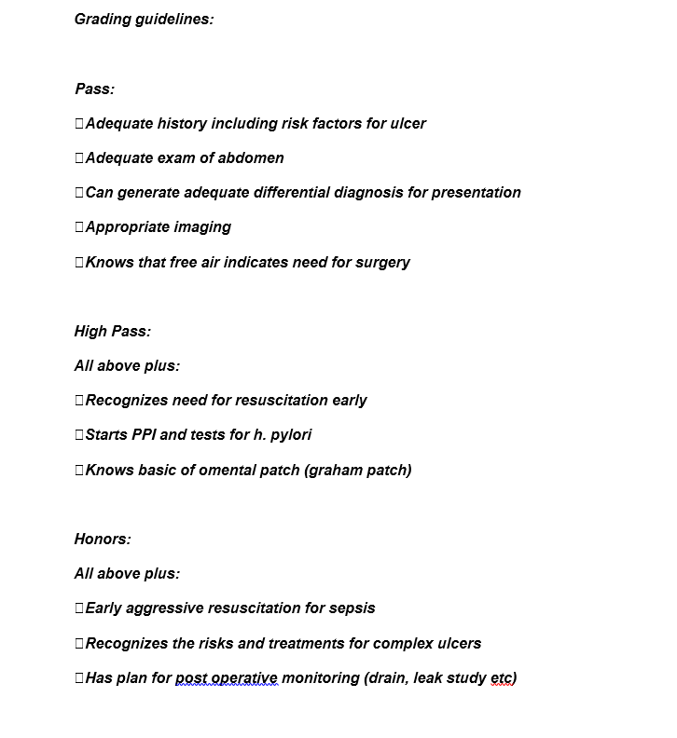
Grading

Slide 37
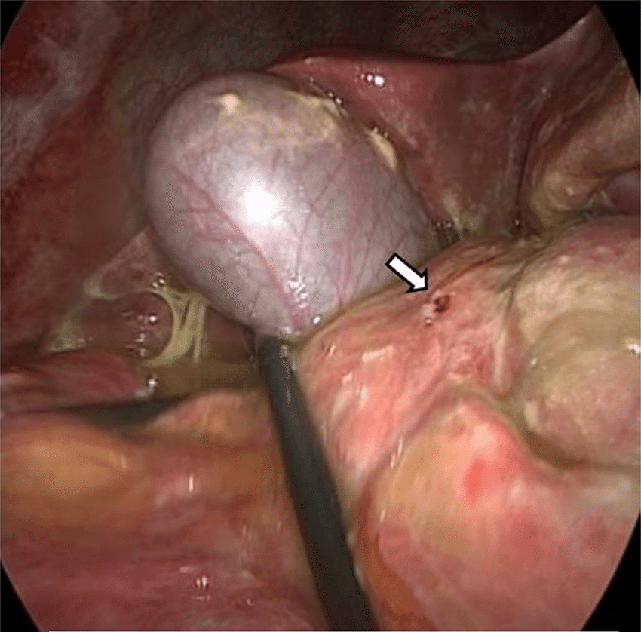
index

Slide 38
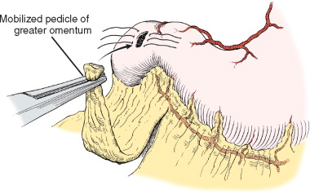
Omental patch (Graham)
index

